Slide 1

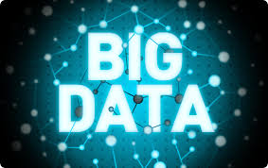
UNIT- 1

Slide 2
Objective of the Subject:
To demonstrate the knowledge and ability to
Covers fundamental principles of Big Data.
To develop a comprehensive understanding of Big Data Analytics.
To understand current and emerging trends in Big Data.

Slide 3
Introduction
Big Data may well be the Next Big Thing in the IT world.
Big data burst upon the scene in the first decade of the 21st century.
The first organizations to embrace it were online and startup firms. Firms like Google, eBay, LinkedIn, and Facebook were built around big data from the beginning.
Like many new information technologies, big data can bring about dramatic cost reductions, substantial improvements in the time required to perform a computing task, or new product and service offerings.

Slide 4
What is BIG DATA?
‘Big Data’ is similar to ‘small data’, but bigger in size
but having data bigger it requires different approaches:
Techniques, tools and architecture
an aim to solve new problems or old problems in a better way
Big Data generates value from the storage and processing of very large quantities of digital information that cannot be analyzed with traditional computing techniques.

Slide 5
What is Big Data?
Big Data is a term applied to data sets whose size is beyond the ability of commonly used software tools to capture, manage, and process within a tolerable elapsed time.
Big Data sizes are a constantly moving target currently ranging from a few dozen terabytes to many petabytes in a single data set.
Examples include
Web logs sensor networks social networks Internet text and documents Internet search indexing call detail records astronomy | Biological genomics medical records scientific research military surveillance photography archives video archive eCommerce

Slide 6

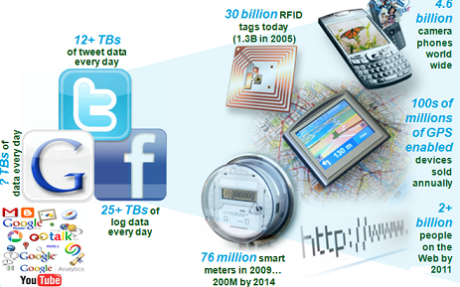
Big Data EveryWhere!
Lots of data is being collected and warehoused
Web data, e-commerce
purchases at department/ grocery stores
Bank/Credit Card transactions
Social Network

Slide 7
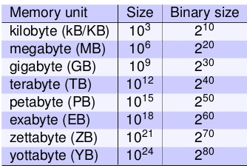
How Many Bytes?
What is the maximum file size you have dealt so far?
What is the maximum download speed you get?
How much time to just transfer.

Slide 8
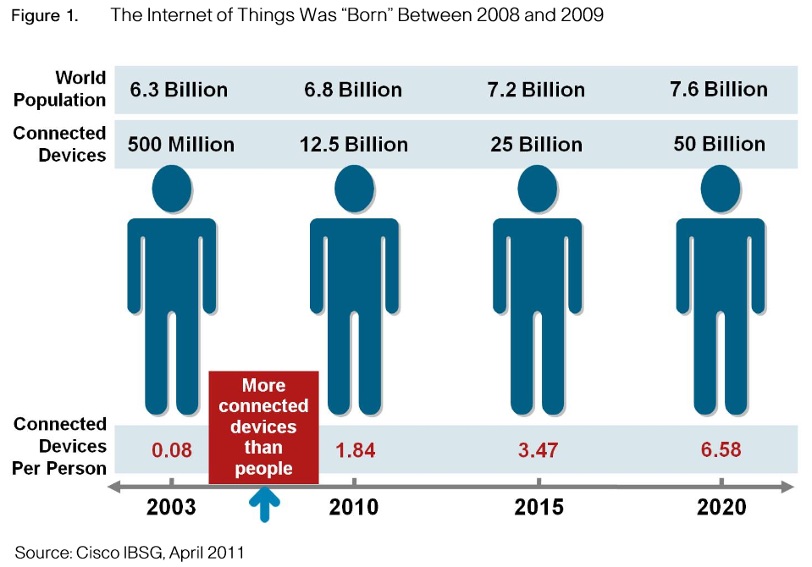
Why Big Data
FB generates 10TB daily
Twitter generates 7TB of data
Daily
IBM claims 90% of today’s
stored data was generated
in just the last two years.

Slide 9
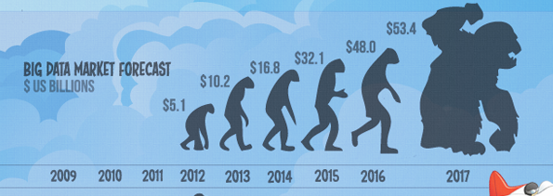
Walmart handles more than 1 million customer transactions every hour.
• Facebook handles 40 billion photos from its user base.
• Decoding the human genome originally took 10years to process; now it can be achieved in one week.

Slide 10
Three Characteristics of Big Data V3s
Volume
Velocity
Data Speed
Variety
Data Types
Data quantity
Notes:
Acco.to IBM
10

Slide 11
Big Data Dimensions (4 V’S)
Volume :refers to mass quantities of data that organizations are trying to harness to improve decision making. High volume may refer data in terms of terabyte or petabyte for small organization and zetabytes and exabytes for big ones.
Turn 12 terabytes of Tweets created each day into improved product sentiment analysis. Convert 350 billion annual meter readings to better predict power consumption
Variety: Data can come from a variety of sources. It may be internal or from external sources. Variety means to manage complexity to manage complexity of multiple data type along with different types of data like structured, semi structured or unstructured data.
Monitor 100’s of live video feeds from surveillance cameras to target points of interest
Velocity: Sometimes 2min is too late for catching fraud or time sensitive applications. It means the frequency of generation and delivery of data i.e. the speed at which data is created, processed and analyzed.
Scrutinize 5 million trade events created each day to identify potential fraud
Variability – This refers to the inconsistency which can be shown by the data at times, thus hampering the process of being able to handle and manage the data effectively.

Slide 12
1st Character of Big Data Volume
A typical PC might have had 10 gigabytes of storage in 2000.
Today, Facebook ingests 500 terabytes of new data every day.
Boeing 737 will generate 240 terabytes of flight data during a single flight across the US.
The smart phones, the data they create and consume; sensors embedded into everyday objects will soon result in billions of new, constantly-updated data feeds containing environmental, location, and other information, including video.

Slide 13
2nd Character of Big Data Velocity
Clickstreams and ad impressions capture user behavior at millions of events per second
high-frequency stock trading algorithms reflect market changes within microseconds
machine to machine processes exchange data between billions of devices
infrastructure and sensors generate massive log data in real-time
on-line gaming systems support millions of concurrent users, each producing multiple inputs per second.

Slide 14
3rd Character of Big Data Variety
Big Data isn't just numbers, dates, and strings. Big Data is also geospatial data, 3D data, audio and video, and unstructured text, including log files and social media.
Traditional database systems were designed to address smaller volumes of structured data, fewer updates or a predictable, consistent data structure.
Big Data analysis includes different types of data

Slide 15
COMPLEXITY
Today's data comes from multiple sources, which makes it difficult to link, match, cleanse and transform data across systems.
However, it’s necessary to connect and correlate relationships, hierarchies and multiple data linkages or your data can quickly spiral out of control.

Slide 16
Big Data sources
Users
Application
Large and growing files
(Big data files)
Systems
Sensors

Slide 17
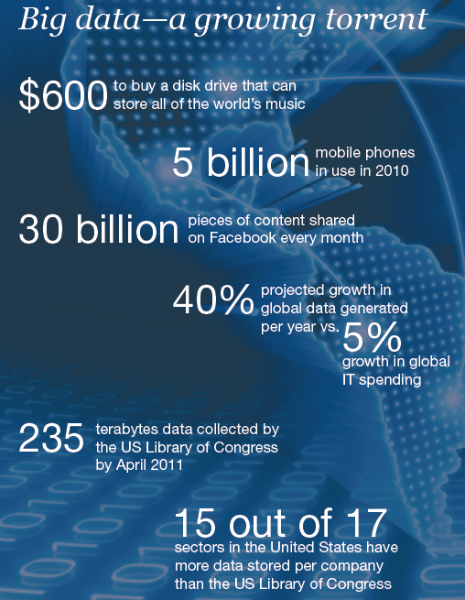
Data generation points Examples
Mobile Devices
Microphones
Readers/Scanners
Science facilities
Programs/ Software
Social Media
Cameras

Slide 18
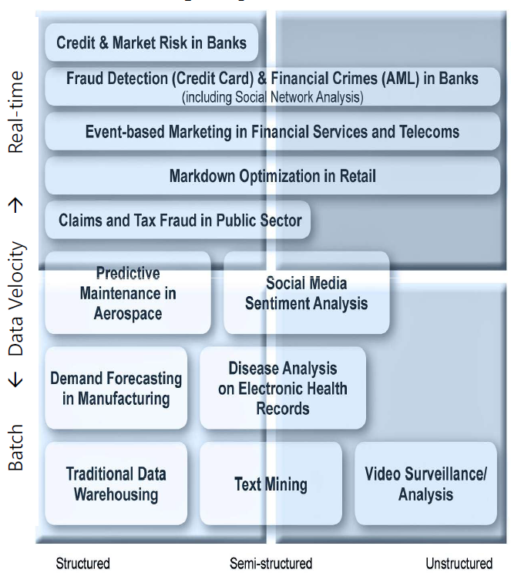
The Structure of Big Data
Structured
Most traditional data sources
Semi-structured
Many sources of big data
Unstructured
Video data, audio data

Slide 19
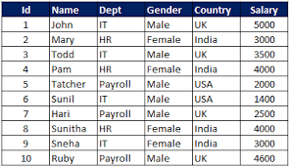
STRUCTURE DATA
Any data that can be stored, accessed and processed in the form of fixed format is termed as a 'structured' data.

Slide 20
Structure Data is divided into
Machine Generated Data
i) Sensor Data
ii)Web log Data
iii) Financial Data
2. Human Generated Data
i) Input Data
ii) Gaming related Data
iii) Click Stream Data

Slide 21
UNSTRUCTURED DATA
Any data with unknown form or the structure is classified as unstructured data.
In addition to the size being huge, un-structured data poses multiple challenges in terms of its processing for deriving value out of it.
Typical example of unstructured data is, a heterogeneous data source containing a combination of simple text files, images, videos etc.
Examples Of Un-structured Data
Output returned by 'Google Search'

Slide 22
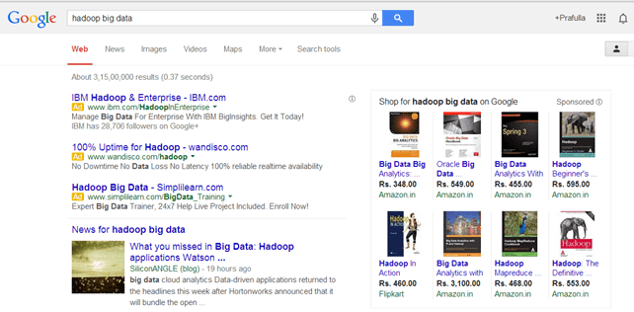

Slide 23
SEMI STRUCTURE DATA
Semi-structured data can contain both the forms of data. We can see semi-structured data as a strcutured in form but it is actually not defined with e.g. a table definition in relational DBMS. Example of semi-structured data is a data represented in XML file.
Examples Of Semi-structured Data
Personal data stored in a XML file-

Slide 24
Continue..
<rec><name>Prashant Rao</name><sex>Male</sex><age>35</age></rec> <rec><name>Seema R.</name><sex>Female</sex><age>41</age></rec> <rec><name>Satish Mane</name><sex>Male</sex><age>29</age></rec> <rec><name>Subrato Roy</name><sex>Male</sex><age>26</age></rec> <rec><name>Jeremiah J.</name><sex>Male</sex><age>35</age></rec>

Slide 25
Lecture-2
Big Data Analytic
Benefits of Big Data
Tools and Techniques
Impact of Big Data on Business
Applications
Future Scope

Slide 26
BIG DATA ANALYTIC

Slide 27
Why Big Data
Growth of Big Data is needed
Increase of storage capacities
Increase of processing power
Availability of data(different data types)
Every day we create 2.5 quintillion bytes of data; 90% of the data in the world today has been created in the last two years alone

Slide 28
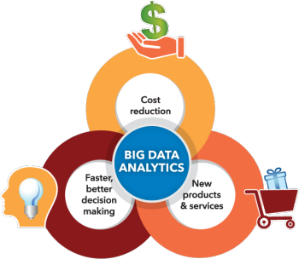
BIG DATA ANALYTICS
Big data analytics helps organizations harness their data and use it to identify new opportunities.

Slide 29
Big Data Analytics
Examining large amount of data
Appropriate information
Identification of hidden patterns, unknown correlations
Competitive advantage
Better business decisions: strategic and operational
Effective marketing, customer satisfaction, increased revenue

Slide 30
Cost reduction. Big data technologies such as Hadoop and cloud-based analytics bring significant cost advantages when it comes to storing large amounts of data – plus they can identify more efficient ways of doing business.
Faster, better decision making. With the speed of Hadoop and in-memory analytics, combined with the ability to analyze new sources of data, businesses are able to analyze information immediately – and make decisions based on what they’ve learned.
New products and services. With the ability to gauge customer needs and satisfaction through analytics comes the power to give customers what they want. Davenport points out that with big data analytics, more companies are creating new products to meet customers’ needs.

Slide 31
How Big data impacts on IT
Big data is a troublesome force presenting opportunities with challenges to IT organizations.
By 2015 4.4 million IT jobs in Big Data ; 1.9 million is in US itself
India will require a minimum of 1 lakh data scientists in the next couple of years in addition to data analysts and data managers to support the Big Data space.

Slide 32
India – Big Data
Gaining attraction
Huge market opportunities for IT services
(82.9% of revenues) and analytics firms
(17.1 % )
Current market size is $200 million. By 2015 $1
billion
The opportunity for Indian service providers lies
in offering services around Big Data
implementation and analytics for global
multinationals

Slide 33
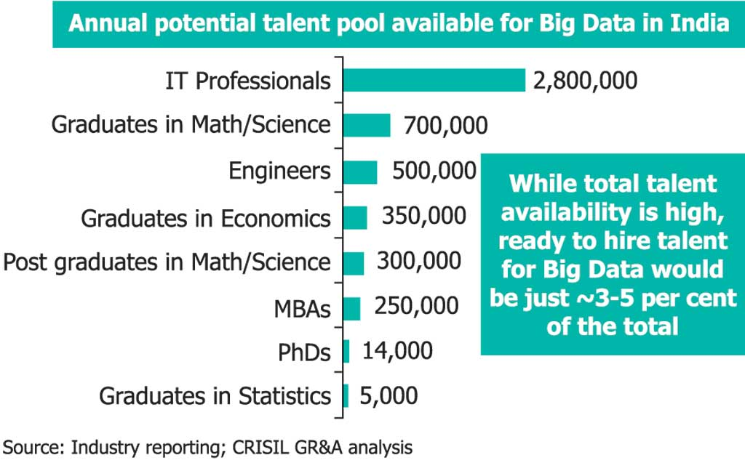
Potential Value of Big Data
$300 billion potential annual value to US health care.
$600 billion potential annual consumer surplus from using personal location data.
60% potential in retailers’ operating margins.

Slide 34
Big Data for the Business
With Big Data databases, enterprises can save money, grow revenue, and achieve many other business objectives, in any vertical.
Build new applications: Big data might allow a company to collect billions of real-time data points on its products, resources, or customers – and then repackage that data instantaneously to optimize customer experience or resource utilization.
For example, a major US city is using MongoDB to cut crime and improve municipal services by collecting and analyzing geospatial data in real-time from over 30 different departments.
Improve the effectiveness and lower the cost of existing applications:
Big data technologies can replace highly-customized, expensive legacy systems with a standard solution that runs on commodity hardware. And because many big data technologies are open source, they can be implemented far more cheaply than proprietary technologies.
For example, by migrating its reference data management application to MongoDB, a Tier 1 bank dramatically reduced the license and hardware costs associated with the proprietary relational database it previously ran, while also bringing its application into better compliance with regulatory requirements.

Slide 35
Realize new sources of competitive advantage:
Big data can help businesses act more nimbly, allowing them to adapt to changes faster than their competitors.
For example, MongoDB allowed one of the largest Human Capital Management (HCM) solution providers to rapidly build mobile applications that integrated data from a wide variety of disparate sources.
Increase customer loyalty:
Increasing the amount of data shared within the organization – and the speed with which it is updated – allows businesses and other organizations to more rapidly and accurately respond to customer demand.
For example, a top 5 global insurance provider, MetLife,used MongoDB to quickly consolidate customer information from over 70 different sources and provide it in a single, rapidly-updated view.

Slide 36
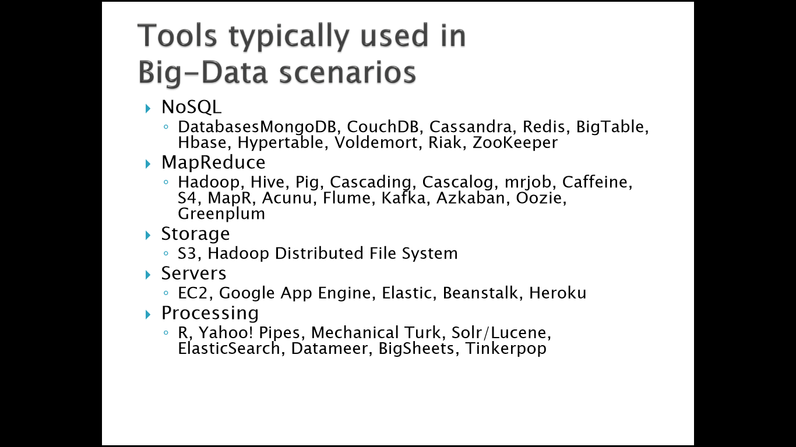

Slide 37
A NoSQL (originally referring to "non SQL", "non relational" or "not only SQL") database provides a mechanism for storage and retrieval of data which is modeled in means other than the tabular relations used in relational databases.
Hadoop is an open-source framework that allows to store and process big data in a distributed environment across clusters of computers using simple programming models. It is designed to scale up from single servers to thousands of machines, each offering local computation and storage.
MapReduce is the heart of Hadoop®. It is this programming paradigm that allows for massive scalability across hundreds or thousands of servers in a Hadoop cluster.

Slide 38
Storing Big Data
Analyzing your data characteristics
Selecting data sources for analysis
Eliminating redundant data
Establishing the role of NoSQL
Overview of Big Data stores
Data models: key value, graph, document, column-family
Hadoop Distributed File System
HBase
Hive

Slide 39
Selecting Big Data stores
Choosing the correct data stores based on your data characteristics
Moving code to data
Implementing polyglot data store solutions
Aligning business goals to the appropriate data store

Slide 40
Processing Big Data
Integrating disparate data stores
Mapping data to the programming framework
Connecting and extracting data from storage
Transforming data for processing
Subdividing data in preparation for Hadoop MapReduce
Employing Hadoop MapReduce
Creating the components of Hadoop MapReduce jobs
Distributing data processing across server farms
Executing Hadoop MapReduce jobs
Monitoring the progress of job flows

Slide 41
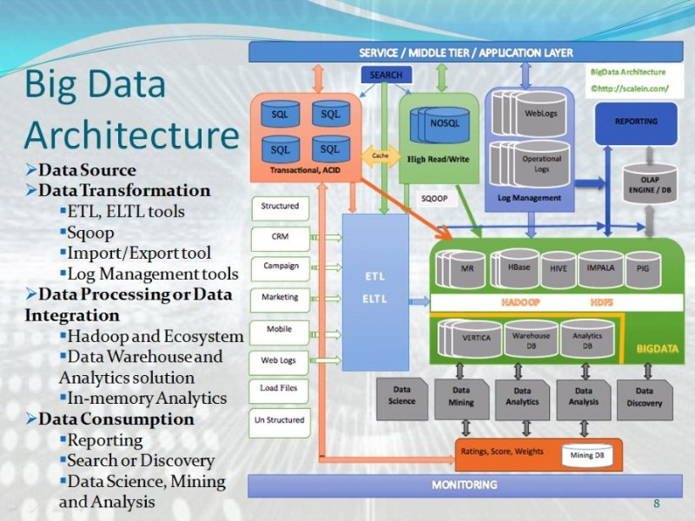

Slide 42
Issues AND CHALLENGES
Heterogeneity and Incompleteness
The difficulties of big data analysis derive from its large scale as well as the presence of mixed data based on different patterns or rules (heterogeneous mixture data) in the collected and stored data.
Incomplete data creates uncertainties during data analysis and it must be managed during data analysis.
Scale and complexity
Managing large and rapidly increasing volumes of data is a challenging issue. Traditional software tools are not enough for managing the increasing volumes of data. Data analysis, Organization, retrieval and modeling are also challenges due to scalability and complexity of data that needs to be analysed.

Slide 43
Timeliness
As the size of the data sets to be processed increases, it will take more time to analyse. In some situations results of the analysis is required immediately. For example, if a fraudulent credit card transaction is suspected, it should ideally be flagged before the transaction is completed by
preventing the transaction from taking place at all. Obviously a full analysis of a user’s purchase history is not likely to be feasible in real time.
Security And Privacy Challenges
privacy of data is a huge concern in the context of Big Data. There is great public fear regarding the inappropriate use of personal data, particularly through linking of data from multiple sources. So, unauthorized use of private data needs to be protected.
Security of big data can be enhanced by using the techniques of authentication, authorization, encryption and audit trails.

Slide 44
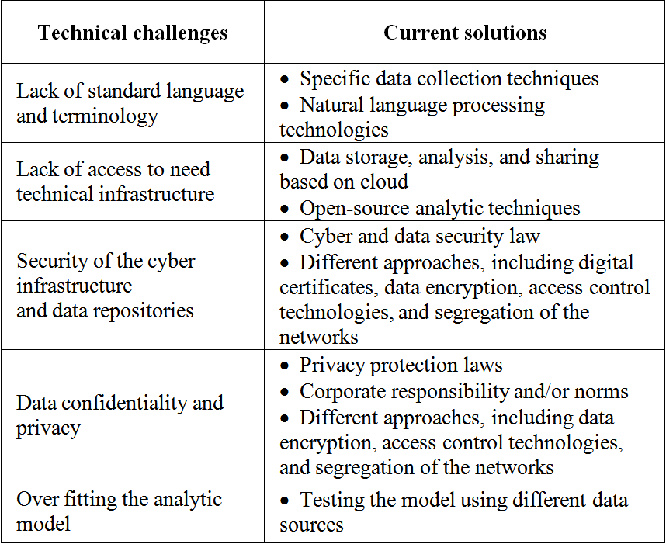
TECHNICAL CHALLENGES

Slide 45
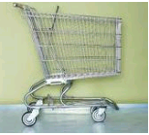

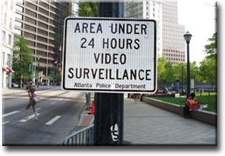


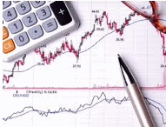
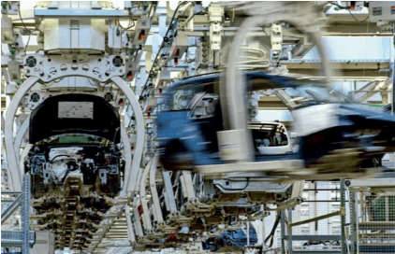

Application Of Big Data analytics
Smarter Healthcare
Multi-channel sales
Homeland
Security
Telecom
Traffic Control
Trading
Analytics
Search
Quality
Manufacturing
Notes:
Quote practical examples

Slide 46
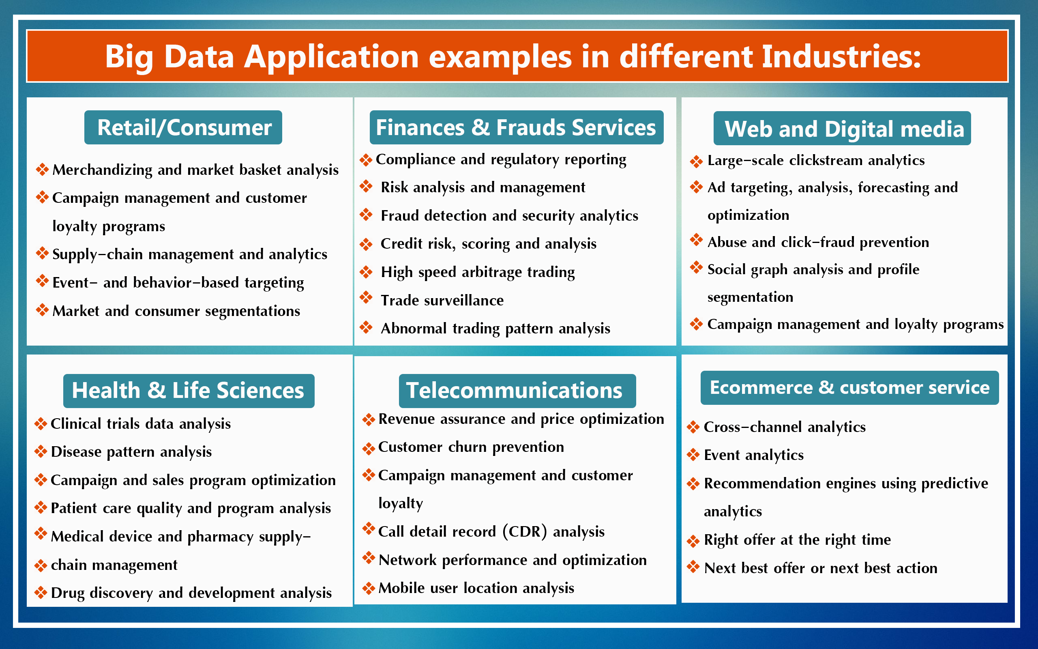

Slide 47
Benefits of Big Data
Ability to process 'Big Data' brings in multiple benefits, such as-
• Businesses can utilize outside intelligence while taking decisions
Access to social data from search engines and sites like facebook, twitter are enabling organizations to fine tune their business strategies.
• Improved customer service
Traditional customer feedback systems are getting replaced by new systems designed with 'Big Data' technologies. In these new systems, Big Data and natural language processing technologies are being used to read and evaluate consumer responses.
• Early identification of risk to the product/services, if any
• Better operational efficiency
'Big Data' technologies can be used for creating staging area or landing zone for new data before identifying what data should be moved to the data warehouse. In addition, such integration of 'Big Data' technologies and data warehouse helps organization to offload infrequently accessed data.

Slide 48
Benefits of Big Data
Our newest research finds that organizations are using big data to target customer-centric outcomes, tap into internal data and build a better information ecosystem.
Big Data is already an important part of the $64 billion database and data analytics market
It offers commercial opportunities of a comparable
scale to enterprise software in the late 1980s
And the Internet boom of the 1990s, and the social media explosion of today.

Slide 49
Future of Big Data
$15 billion on software firms only specializing in data management and analytics.
This industry on its own is worth more than $100 billion and growing at almost 10% a year which is roughly twice as fast as the software business as a whole.
In February 2012, the open source analyst firm Wikibon released the first market forecast for Big Data , listing $5.1B revenue in 2012 with growth to $53.4B in 2017
The McKinsey Global Institute estimates that data volume is growing 40% per year, and will grow 44x between 2009 and 2020.

Slide 50
Thank You.

